Slide 1
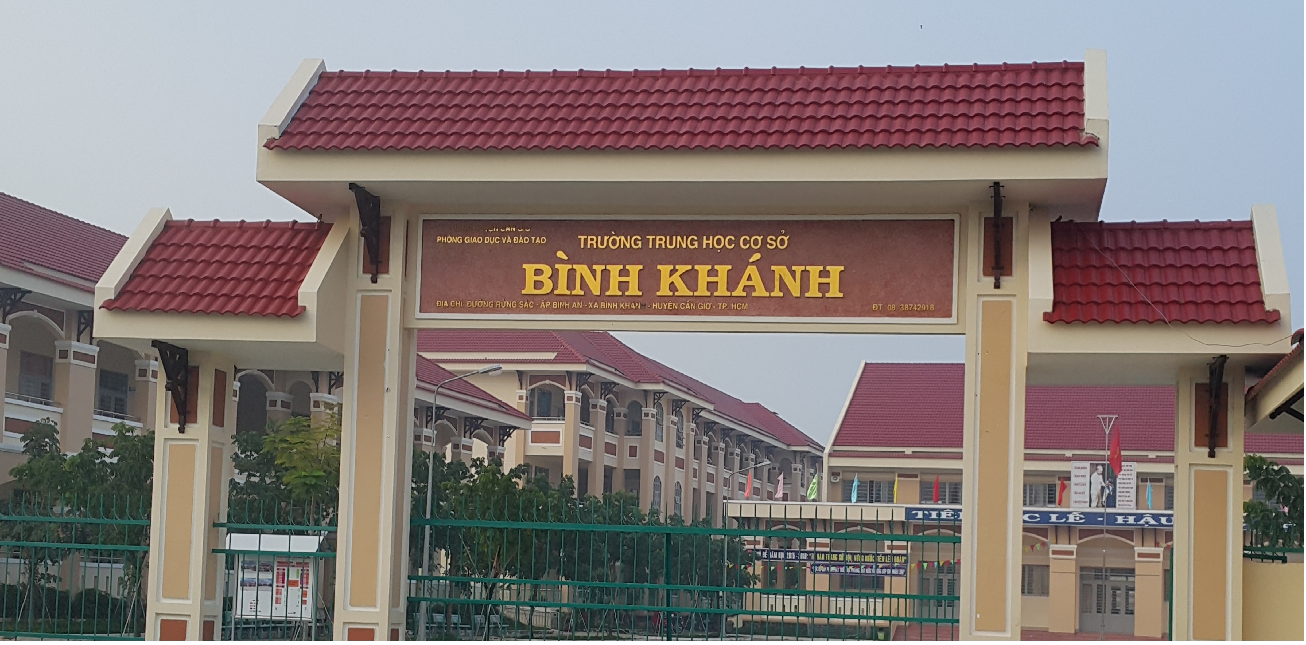
ENGLISH 9
BINH KHANH SECONDARY SCHOOL

Slide 2




ENGLISH 9
UNIT 6: THE ENVIRONMENT
Lesson 1:Getting started-Listen and read

Slide 3
Air pollution
Smoke from factories
Water pollution
ENVIRONMENTAL
PROBLEMS EFFECT
TO OUR LIFE
Sewage
Smoke from cars/motorbikes
Spraying pesticides

Slide 4
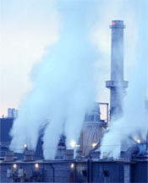
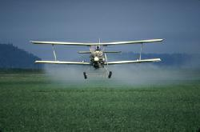
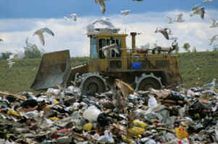
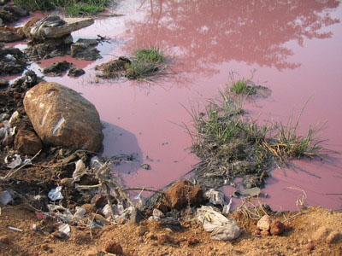
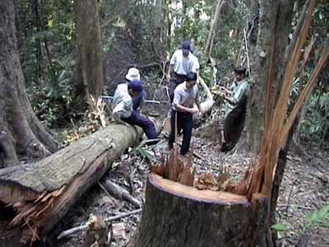
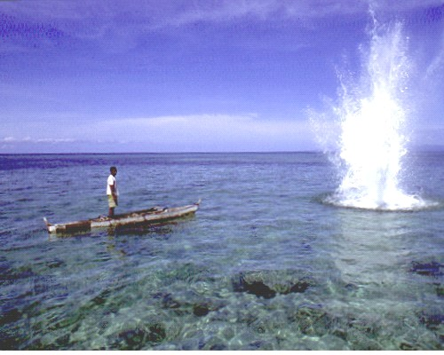
I.GETTING STARTED:
Match these environmental problems to the pictures.
garbage dump
air pollution
water pollution
deforestation
dynamite fishing
spraying pesticides
a)
b)
c)
d)
e)
f)

Slide 5
Picture a- 2 Air pollution:
Picture b- 6 Spraying pesticides:
Picture c - 1 Garbage dump:
Picture d - 3 Water pollution:
Picture e - 4 Desforestation:
Picture f - 5 Dynamite fishing:
Sự ô nhiễm không khí
Việc phun thuốc trừ sâu
Bãi đổ rác
Sự ô nhiễm nước
Sự tàn phá rừng
Đánh bắt cá bằng thuốc nổ

Slide 6
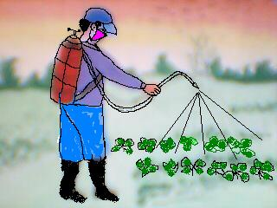
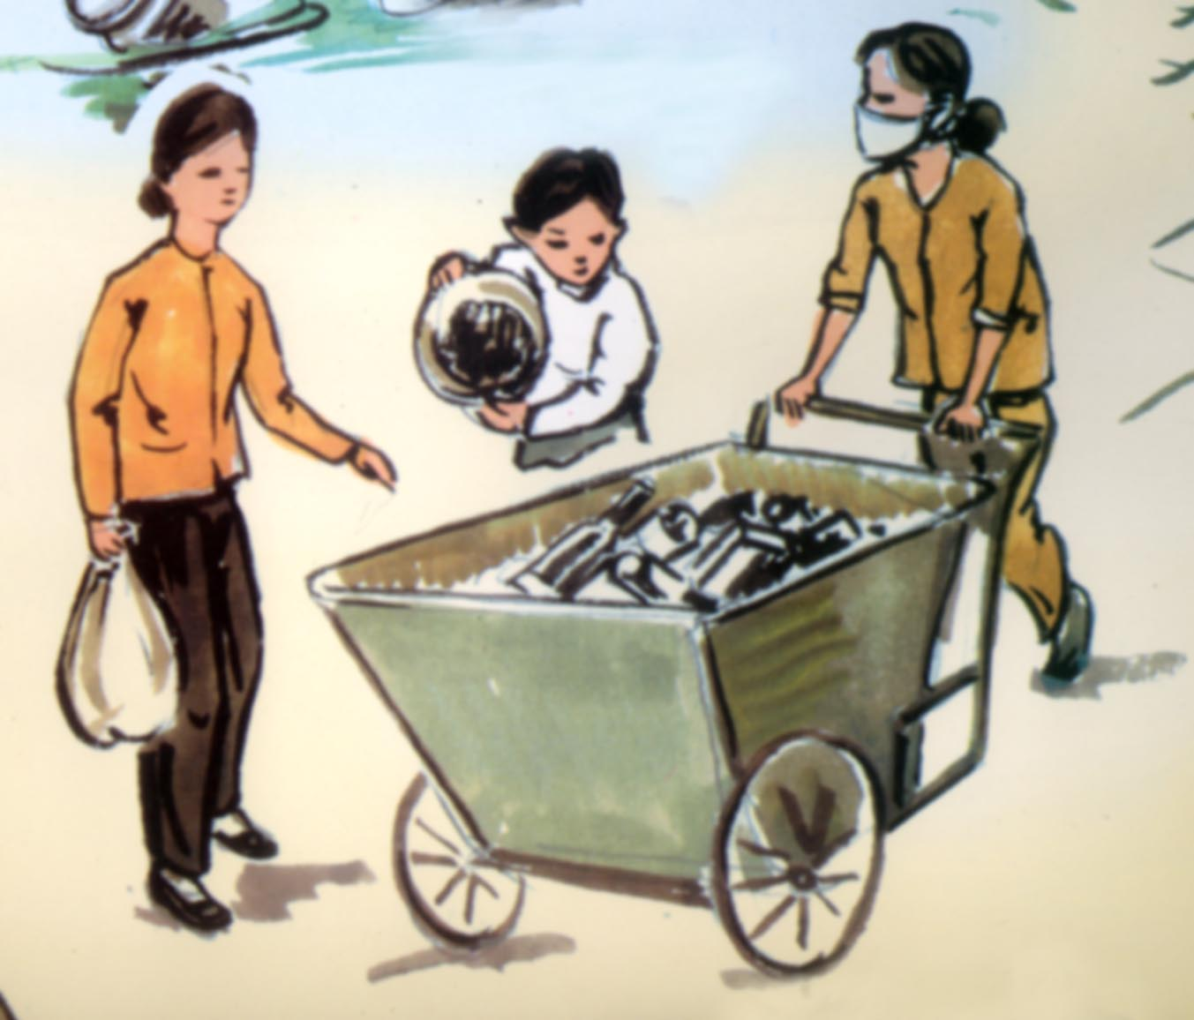
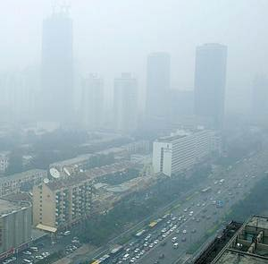
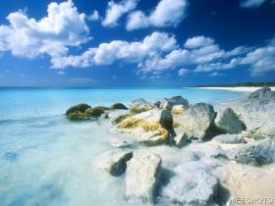
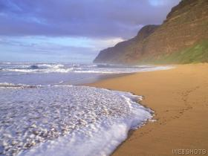
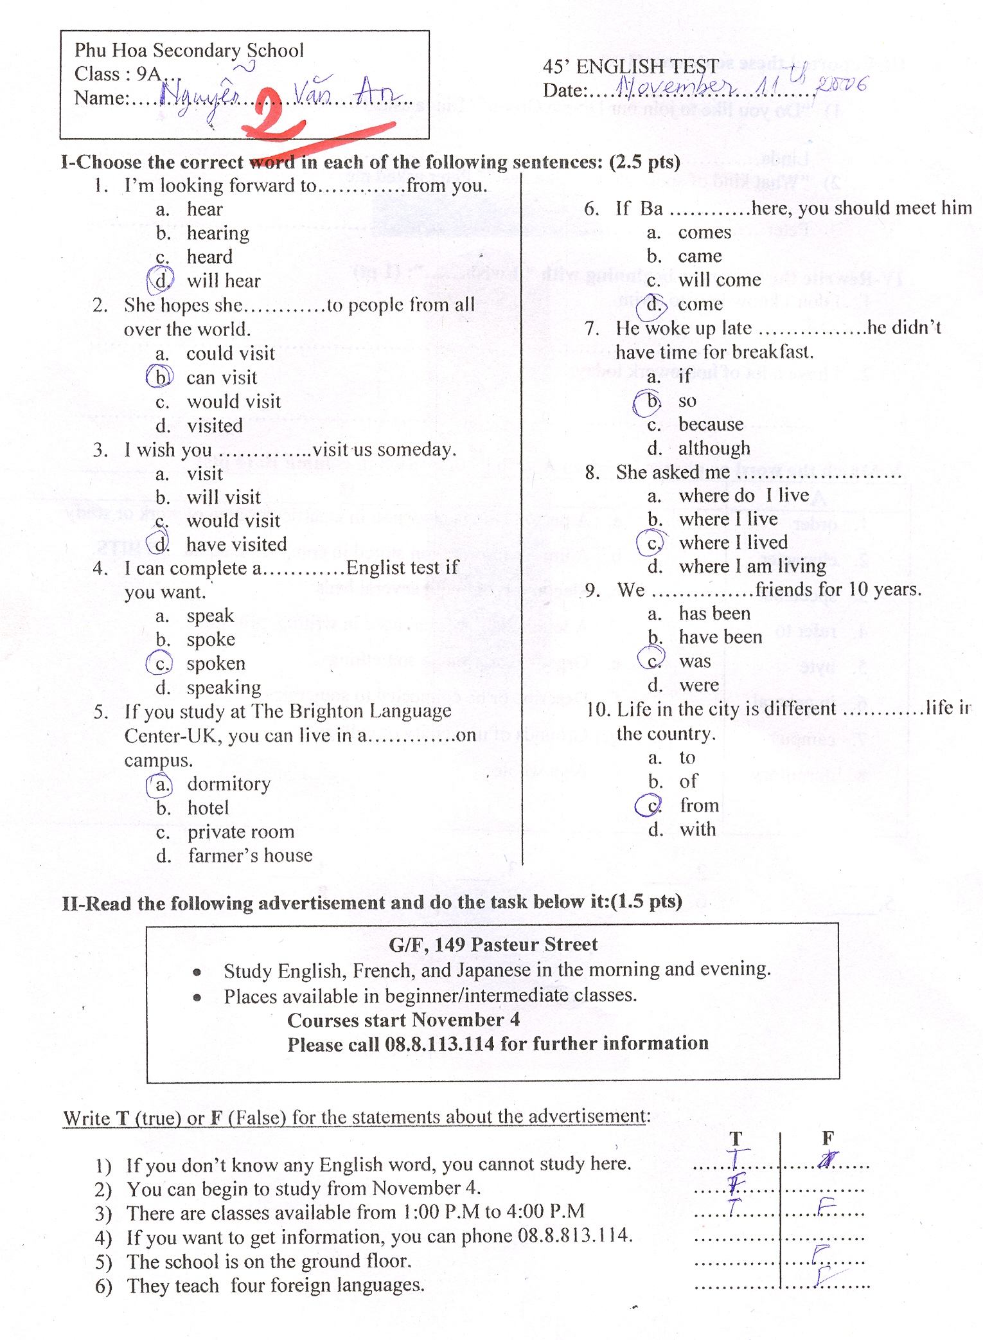
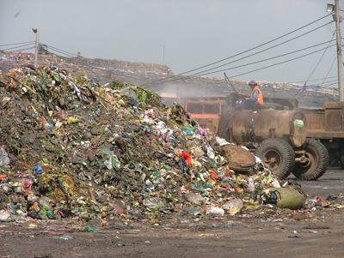
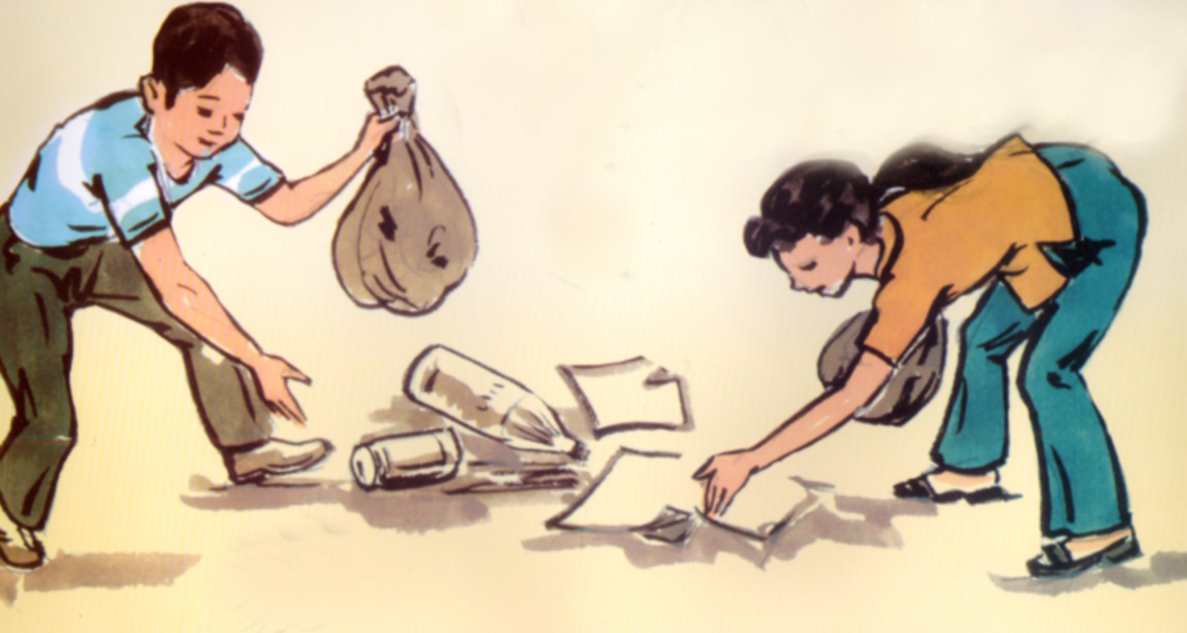
UNIT 6: THE ENVIRONMENT
Lesson 1:Getting started-Listen and read
II.LISTEN AND READ:
1.Vocabualary:
Pollute(v): làm ô nhiễm
pollution (n) sự ô nhiễm
-Conservationist :người bảovệ môitrường
Pesticide (n)thuốc trừ sâu
shore (n):bờ biển
Rock (n) :tảng đá
Spoil (v): làm hỏng, hủy hoại
Disappointed (adj):thất vọng
Jumbled words
ltnopouil
Rhsoe
Kcro
voincnostretais
pollution
Shore
Rock
Conservationist

Slide 7
Match the names in column A with the task in column B.Then write the full sentences.
2.Matching prediction:
1. Group 1
2. Group 2
3. Group 3
4. Mr. Jones
5. Mrs. Smith
6. Mr. Brown
a) Collect all the bags and take them to the garbage dump
b)Check among the rocks.
c) Provide a picnic lunch for everyone.
d)Give out the bags.
e)Check the sand.
f)Walk along the shore.

Slide 8
Mr. Brown and some volunteer conservationists are going to clean the beach. Listen and read and find out what of them is going to do. What does Mr. Brown want to happen to the beach?
3.Practice:
Listen and Read
Mr. Brown is talking to some volunteer conservationists.
“ I want everyone to listen carefully, please. First of all, I’d like you to divide into three groups. Each group should take five plastic bags. Once you have filled a bag, come back to me as you will need another. I need group one to walk along the shore. Group two should check the sand, and group three has to check among the rocks. Mr. Jones is going to collect all the bags and take them to the garbage dump. Mrs. Smith has kindly provided a picnic lunch for us, but we won’t eat until the whole area is clean. If you can’t find your place, I will help you get there with this map. Don’t worry. … uh … I’m disappointed that people have spoiled this area. However, we are here to do something about this pollution. We must all work very hard. And, if we work hard, we’ll make this beach a clean and beautiful place again. OK. Now, let’s get started.”

Slide 9
UNIT 6: THE ENVIRONMENT
Lesson 1:Getting started-Listen and read
I. GETTING STARTED
II.LISTEN AND READ
1. New words:
-Pollute(v):
-pollution (n)
-Conservationist
-Pesticide
shore (n):
Rock (n) :
Spoil (v): Disappointed
2.Matching:
3.Practice:
II.LISTEN AND READ:
Mr. Brown is talking to some volunteer conservationists.
“ I want everyone to listen carefully, please. First of all, I’d like you to divide into three groups. Each group should take five plastic bags. Once you have filled a bag, come back to me as you will need another. I need group one to walk along the shore. Group two should check the sand, and group three has to check among the rocks. Mr. Jones is going to collect all the bags and take them to the garbage dump. Mrs. Smith has kindly provided a picnic lunch for us, but we won’t eat until the whole area is clean. If you can’t find your place, I will help you get there with this map. Don’t worry. … uh … I’m disappointed that people have spoiled this area. However, we are here to do something about this pollution. We must all work very hard. And, if we work hard, we’ll make this beach a clean and beautiful place again. OK. Now, let’s get started.”
1-f, 2-e, 3-b,
4-a, 5-c, 6-d
Listen and Read

Slide 10

LUCKY NUMBER

Slide 11
4.Playing game :
Lucky number
1
2
3
4
5
6
7
8

Slide 12
1. Who is the speaker?
Mr. Brown is the speaker

Slide 13
2. Who are the listener?
> Some volunteer conservationists

Slide 14
3. Where are they ?
They are on the beach

Slide 15
4. What are they going to do?
They are going to clean the beach

Slide 16
5. What will they achieve if they work hard today?
If they work hard today, they will make the beach clean and beautiful

Slide 17
6. Have you ever polluted the environment ?
Yes, I have.

Slide 19
CONGRATULATION !

Slide 20
UNIT 6: THE ENVIRONMENT
Lesson 1:Getting started-Listen and read
I. GETTING STARTED
II.LISTEN AND READ
1. New words:
-Pollute(v):
-pollution (n)
-Conservationist
-Pesticide
shore (n):
Rock (n) :
Spoil (v): Disappointed
2.Matching:
3.Practice:
II.LISTEN AND READ:
Mr. Brown is talking to some volunteer conservationists.
“ I want everyone to listen carefully, please. First of all, I’d like you to divide into three groups. Each group should take five plastic bags. Once you have filled a bag, come back to me as you will need another. I need group one to walk along the shore. Group two should check the sand, and group three has to check among the rocks. Mr. Jones is going to collect all the bags and take them to the garbage dump. Mrs. Smith has kindly provided a picnic lunch for us, but we won’t eat until the whole area is clean. If you can’t find your place, I will help you get there with this map. Don’t worry. … uh … I’m disappointed that people have spoiled this area. However, we are here to do something about this pollution. We must all work very hard. And, if we work hard, we’ll make this beach a clean and beautiful place again. OK. Now, let’s get started.”
1-f, 2-e, 3-b,
4-a, 5-c, 6-d
Listen and Read

Slide 21


III.Grammar: Conditional sentences Type1
Ex: If they work hard, they will make the beach a clean and beautiful place again.
If clause ,
Main clause
Present simple
Future simple
Usage:Câu điều kiện loại 1: Dùng để diễn tả hành động, sự việc,một khả năng có thể xảy ra thật ở hiện tại hoặc tương lai.
Ex: If we plant more trees, we will have more fresh air.

Slide 22

III.Grammar: Conditional sentences Type1
Ex: If they work hard, they will make the beach a clean and beautiful place again.
Ex: If we plant more trees, we will have more fresh air.
Main clause if clause
Future simple
Present simple
Ex: They will make the beach a clean and beautiful place again If they work hard .
Ex: We will have more fresh air If we plant more trees.

Slide 23
Practice
pollute
a) If we (pollute) ………. the water, we will have no fresh water to use.
will make
b) She (make) ……………the school yard polluted if she goes on littering.
plants
c) If he (plant)………more trees, he will have more shade and fresh air.
will be
d) If they cut down the trees in the forests, there (be)…………big floods
every year.

Slide 24
UNIT 6: THE ENVIRONMENT
Lesson 1:Getting started-Listen and read
I. GETTING STARTED:
II.LISTEN AND READ
1. New words:
Deforestation(n)
Pollute(v)->pollution
Garbage dump:
Dynamite (n)
Pesticide (n)
Disappointed (adj.)
Volunteer conservationist:
Spoil (v)
Achieve (v)
2.Practise:
3.Matching:
4.Answer the questions
1.The speaker is Mr. Brown
2. The listeners are volunteer conservationists.
3. They are on the beach.
4. They are going to clean the beach.
5. If they work hard today, they will make
this beach a clean and beautiful place again.
6. Yes, I have/ No, I haven’t.
III.Grammar: Conditional sentences Type1
Form:
1/ If clauce , Main clause
2/ Main clause If clauce
Use: Diễn tả hành động, sự việc có khả năng xảy ra thật ở hiện tại hoặc tương lai.
Listen and Read
IV.CONSOLIDATION :
1-f, 2-e, 3-b, 4-a, 5-c, 6-d
V.HOMEWORK :

Slide 25
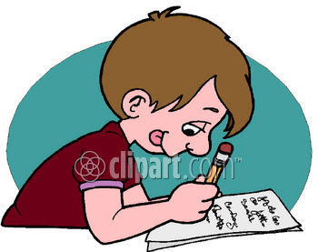

Homework
1
Learn vocabulary by heart.
2
Practice reading the text.
3
Prepare Speak and Listen.
4
Do the exercises in the workbook.

Slide 26
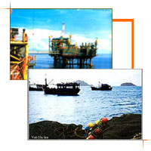


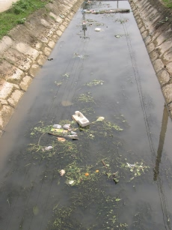
Why is the water polluted?

Slide 27

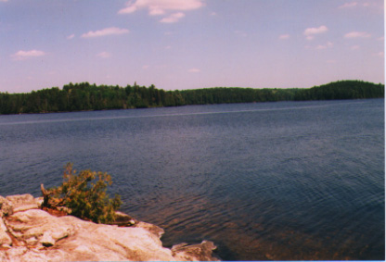




What You Can Do!!!

Slide 28
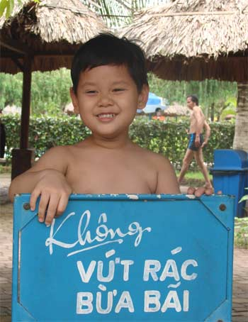
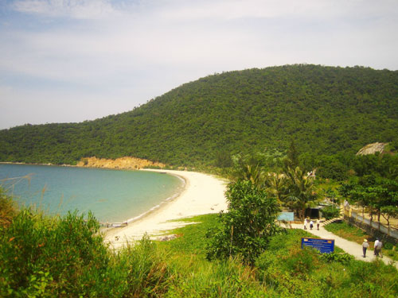
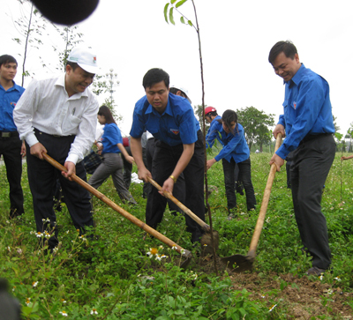
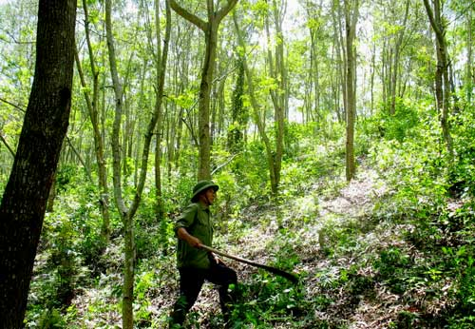
No literring
Make the beach clean and clear
Preserve the forest
Plant more trees

Slide 29
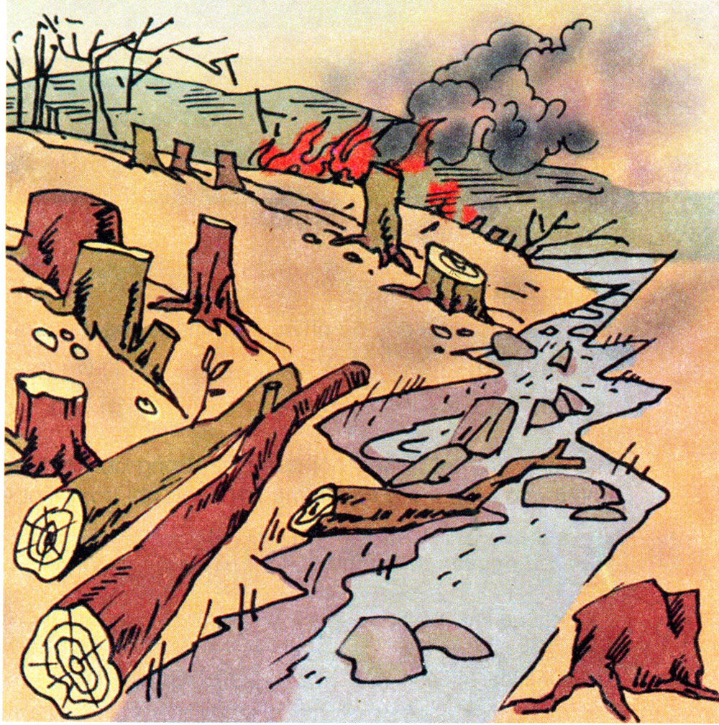
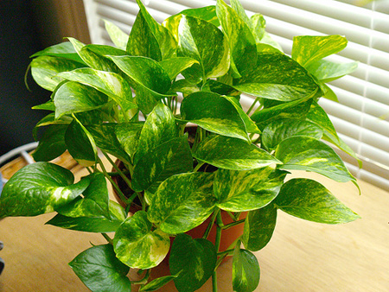
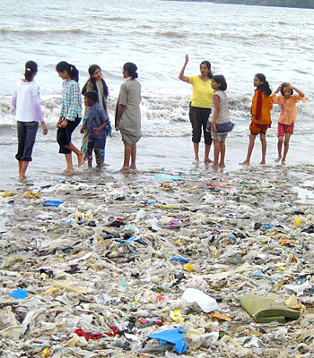
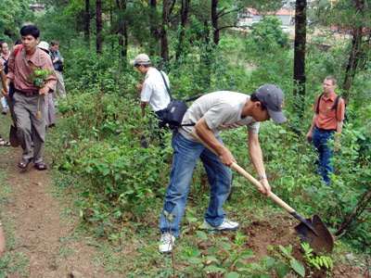
Which ones are the good and bad things?
Good things:
Bad things:
B
C
B
C
A
A
E
E
D
D
F
F

Slide 30



Thanks for your attention.

